Slide 1


ROS Workshop 1: Introduction
Robot Operating System
Notes:
Introduce yourself:
- EEE/4
- MLDA acads
- MLDA robotics

Slide 2


MLDA@EEE - Our Mission
Provide an integrated platform for EEE/IEM students to learn and implement Machine Learning, Data Science & AI, as well as facilitate connections with the industry.
Training Area with CYNAP Core system for collaboration and presentation
MLDA@EEE
FYP/DIP/URECA
Industry Projects
>17 Workshops
>1000 Trained ML practitioners
>10 Academic Projects
>30 Industry projects
>5 competition
>15 Industry Partners
18 AIO workstations
6 Deep Learning Workstations, 4 Nvidia GTX 1080i cards each
ML Career Kickstart
events
Ample space for project work
GPU Servers (4 x V100 + 6 x V100) and storage server
Workshops
&
Competition
Notes:
MLDA@EEE is a student centric lab (run mainly by students, for students)
We aim to provide a platform to empower our EEE/IEM students in learning and deploying ML and data analytics skills in both academia and industry (so to facilitate *you* in learning ML and data analytics)
However we do not just reserve ourselves to EEE/IEM students, others are welcome too
If you wanna learn more about MLDA please visit our social media at LinkedIn, Instagram, YouTube

Slide 3
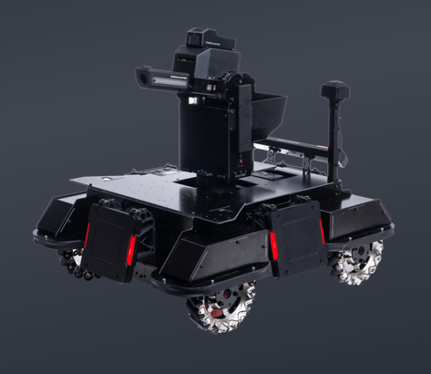
MLDA Robotics
New initiative from MLDA@EEE
Robotics + deep learning
Activities:
Workshops
Projects (e.g. Tello drone project)
Competition
https://www.robomaster.com/en-US/robo/icra
Notes:
Mention about RMUA!

Slide 4
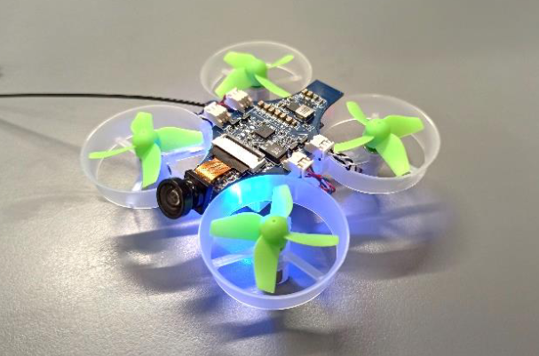
UAVionics Club
Notes:
Collaboration with UAVionics club
Some of the facils today are UAVionics club representatives
What they do: drones of course!

Slide 5
Flow of Today’s Workshop
Introduction to ROS and its ideas (advantages, why we use it, etc.)
ROS fundamental concept (nodes, topics, etc.)
Hands-on session
Writing a very simple example of application
Running a simulation demo
Notes:
We won’t be covering too much today.
You’ll realize it’s also important to know coding e.g. C++ and Python.
Today’s workshop will be kind of slow-paced.

Slide 6
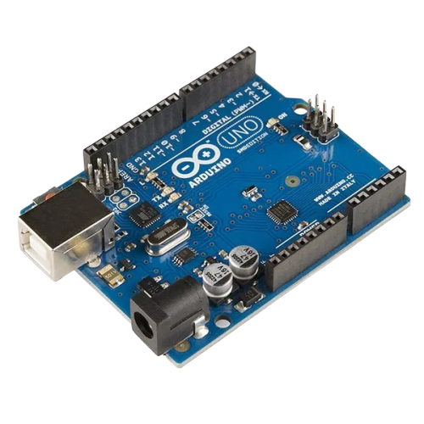
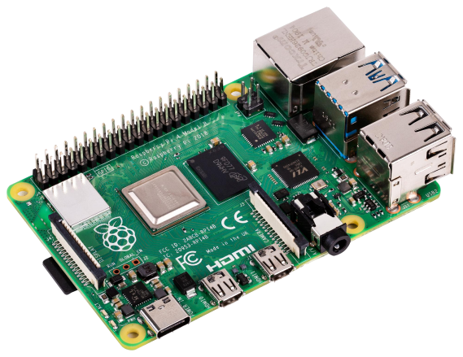

What is Robot Operating System?
Full-blown OS?
Microcontroller
firmware?
OS for embedded
computers?
Notes:
ROS is not a standalone OS, contrary to its name

Slide 7
What is ROS?
Computer (e.g. Raspberry Pi, embedded computers)
Operating System (e.g. Ubuntu)
ROS
Image processing
Navigation
Deep Learning
Localisation
Wheels and
Motor controller
Sensors
Notes:
ROS is a “middleware” for creating robot applications.
Runs on top of OS (normally Ubuntu)
On ROS runs the robotic software (components of it working together)

Slide 8

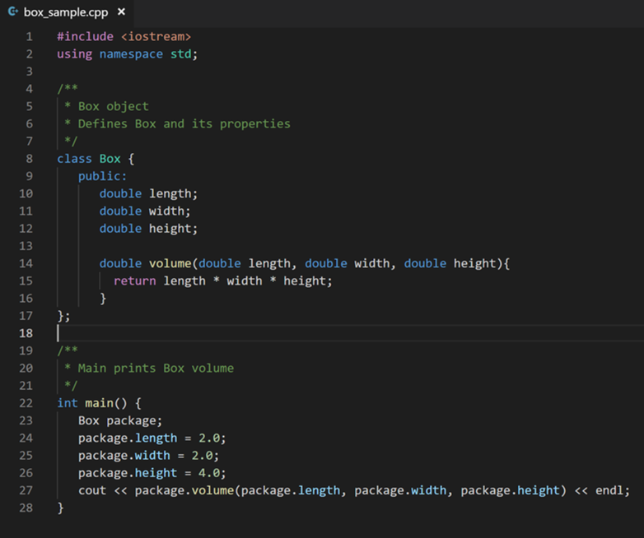
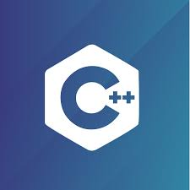
How do we develop robotic software?
Sensors
Navigation
OR
Wheels and
Motor controller
Notes:
Say we do not have or use ROS
Robot has multiple components to it, need to write software for all the different parts
How to combine all that together? Is it easy to use multiple programming languages for different parts?
How about working in a team of people? How to coordinate?
Wouldn’t it be nice to have a framework to (1) make all these components work together modularly (2) standardize

Slide 9
ROS to the Rescue!
Sensors
Navigation
Navigation
Both!
Wheels and
Motor
controller
Sensors
OR
Wheels and
Motor controller
Notes:
You can choose both C++ & Python (even use them both at the same time for a robot project). They can even communicate with each other with no problem!
With ROS, all your code can be separated; each of your components can be its own code (written in language of choice)
The different codes or components can talk to each other / communicate in (sort of) real time

Slide 10
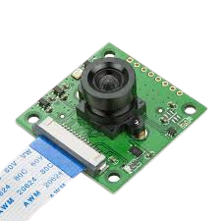


ROS to the Rescue!
Notes:
As long as you know how to write/program the individual “components” of the robot, you can integrate theoretically anything with ROS!
You can integrate all sorts of hardware with ROS (including e.g. Arduino)
…or even software stuff such as deep learning

Slide 11
What’s special about ROS?
Open source; anyone can contribute!
Modular; integrate different individual parts and multiple people can work on different parts of the project at the same time
Streamline and standardized format of the data being sent
Allows communication/coordination with multiple robots
Large community & widespread use
Prebuilt packages for components, hardware drivers, sensors, algorithms, navigation, etc.

Slide 12
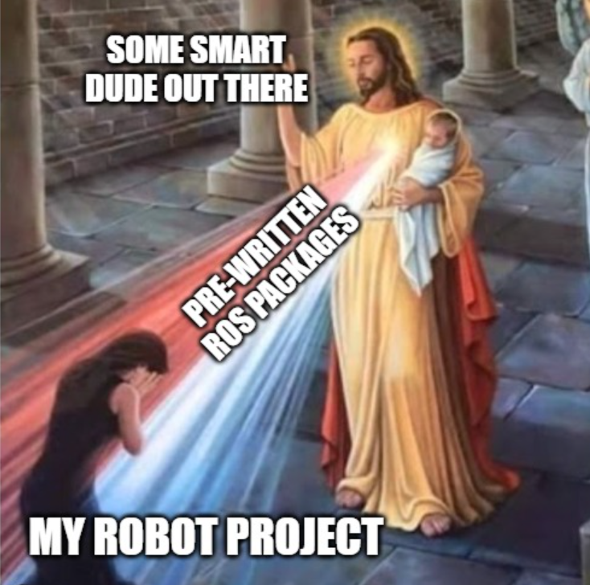
Notes:
Being modular and popular, you can often find the code for “components” of your robot already written by someone

Slide 13
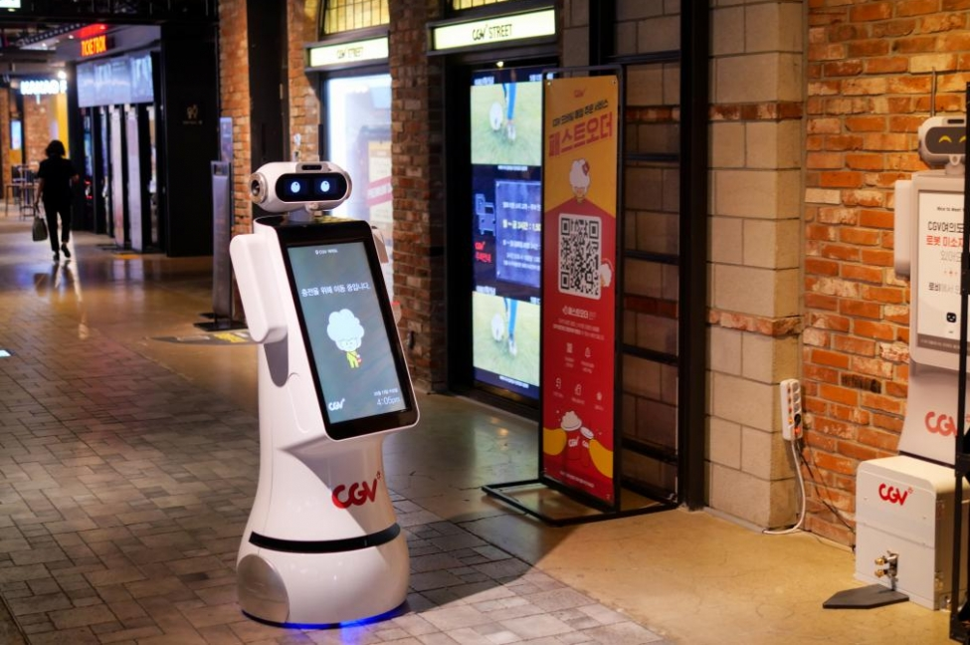
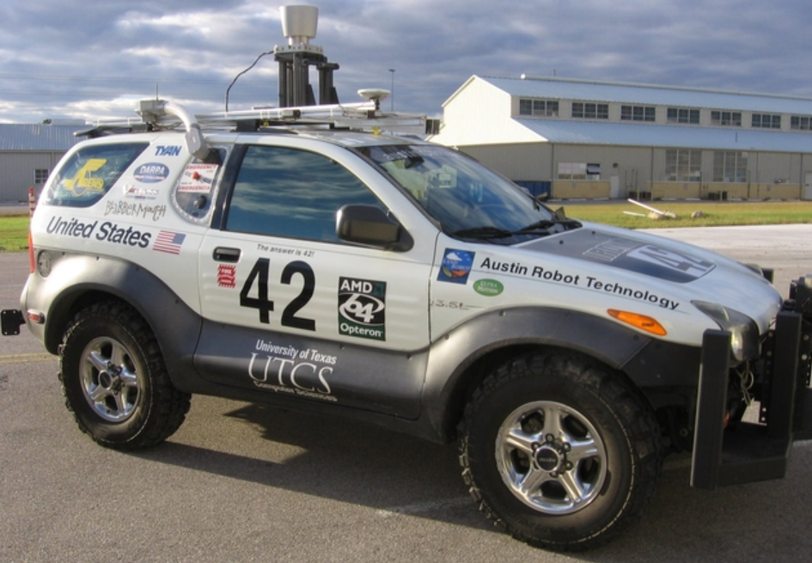
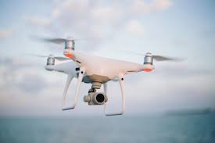
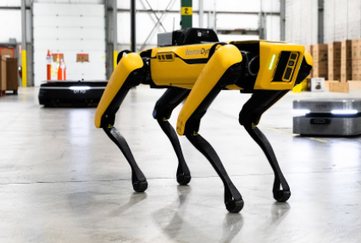
Applications
Notes:
Autonomous cars
Industrial robotics, etc

Slide 14
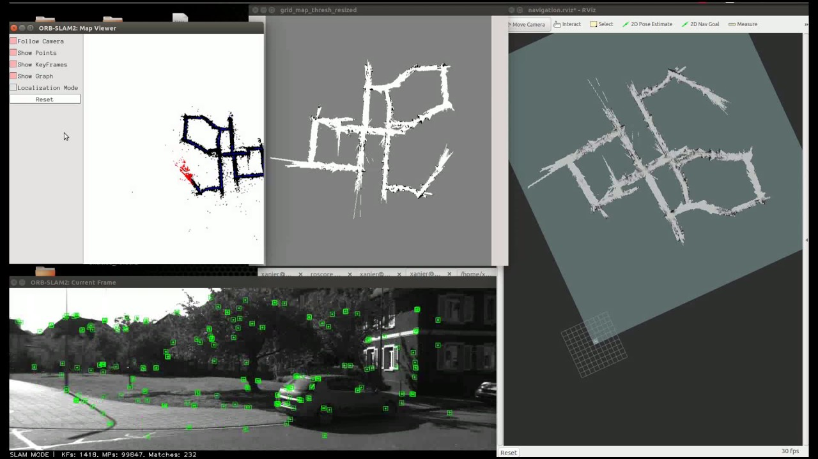
Applications
Notes:
Being open-source and widespread, you can often find packages performing certain types of work
These packages can be challenging to write on your own
This example: SLAM; you can integrate SLAM into your robot with ROS without much difficulty

Slide 15
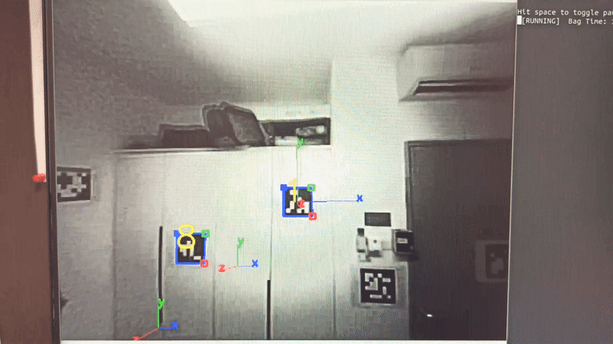
Applications
Notes:
Another example: vision marker detection for drone localization

Slide 16

How about ROS2?
Notes:
ROS has actually come a long way and v2 has been out for a while now, but we’ll focus on v1

Slide 17
ROS Fundamental Concepts
Nodes
Topics
Messages
Notes:
Fundamental ROS concept: nodes, topics, messages

Slide 18
What are ROS Nodes?
ROS
Navigation
Wheels and
Motor controller
Sensors
Notes:
Remember how in ROS you can split the robot’s components into their own code/script
These individual code/component is a ROS node
It can do very specific task like controlling the robot wheels, or be a GUI, or do complicated tasks such as calculating and plotting a path from a map

Slide 19
What are ROS Topics? Messages?
ROS
Navigation
Wheels and
Motor controller
Sensors
Notes:
Now how do the nodes communicate with each other?
The nodes communicate with each other via topics
You can think of topics as “channels”. Each topic (channel) can connect different nodes together and carry specific type of data
This data that are inside the topic are called “messages” in ROS.

Slide 20

ROS Topics & Messages
What is typically inside ROS messages?
Header (timestamp, sequence number, etc.)
Actual data content
Data format
Information of a ROS topic:
Name
Message type that it carries
Sender (publisher)
Receiver (subscriber)

Slide 21
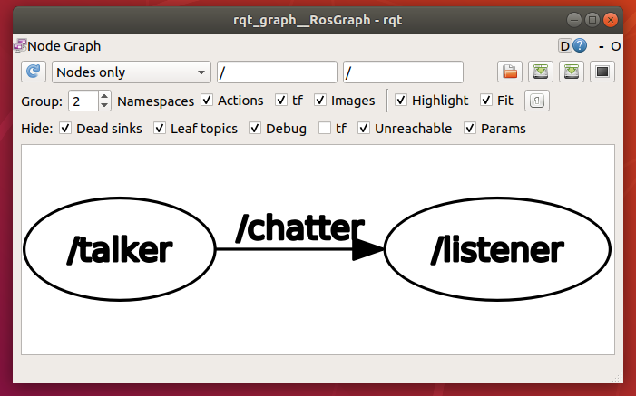
ROS Node & Topic: Example
Topic
Publisher
Subscriber

Slide 22
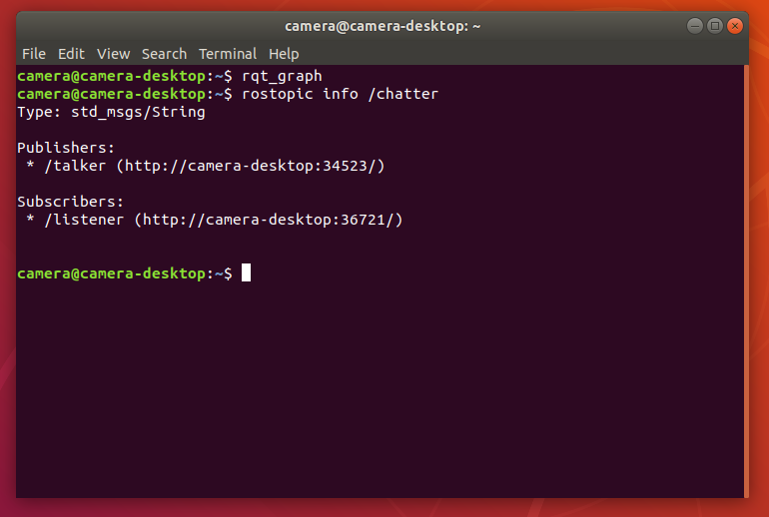
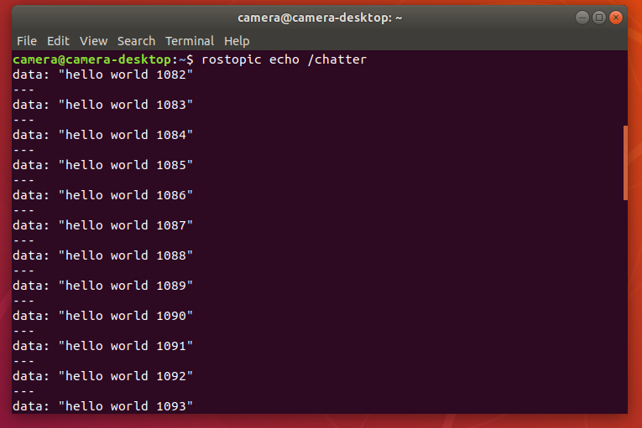
ROS Topic & Message: Example

Slide 23
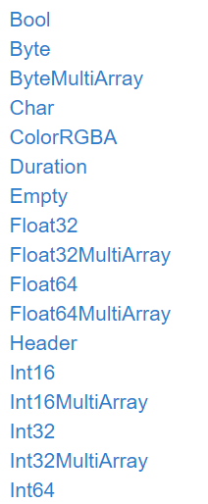
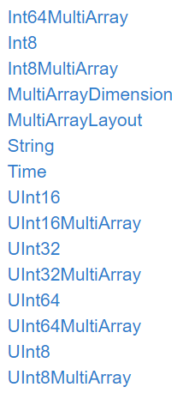
Standard ROS Messages (std_msgs)
Notes:
These message types come built-in with ROS, you can directly use them
You can define custom message types (formats) but we won’t cover that now

Slide 24
ROS Master (roscore)
Allows nodes to discover each other so they can communicate (via ROS topics).
Only one instance of ROS master for the entire robot (or even multiple robots connected via the internet).
Must be running throughout the entire lifetime of the robot software. If ROS master dies, everything dies!
Notes:
The role of the Master is to enable individual ROS nodes to locate one another. Once these nodes are able to locate one another, they can communicate with each other peer-to-peer.
The protocol used for communication is a modified version of TCP (Transmission Control Protocol), called TCPROS
Basically, it's the server and in order for nodes to communicate with each other, it must be active.
ROS master is NOT a node!

Slide 25
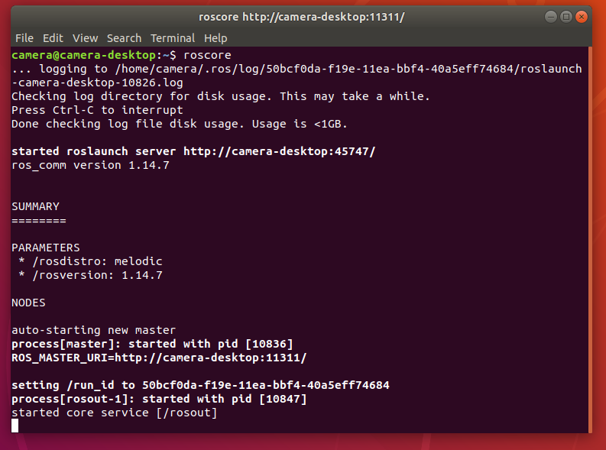
ROS Master
Notes:
ROS master can be run by running roscore in the terminal.

Slide 26
Hands-on!
Notes:
Distribute cheatsheet!

Slide 27
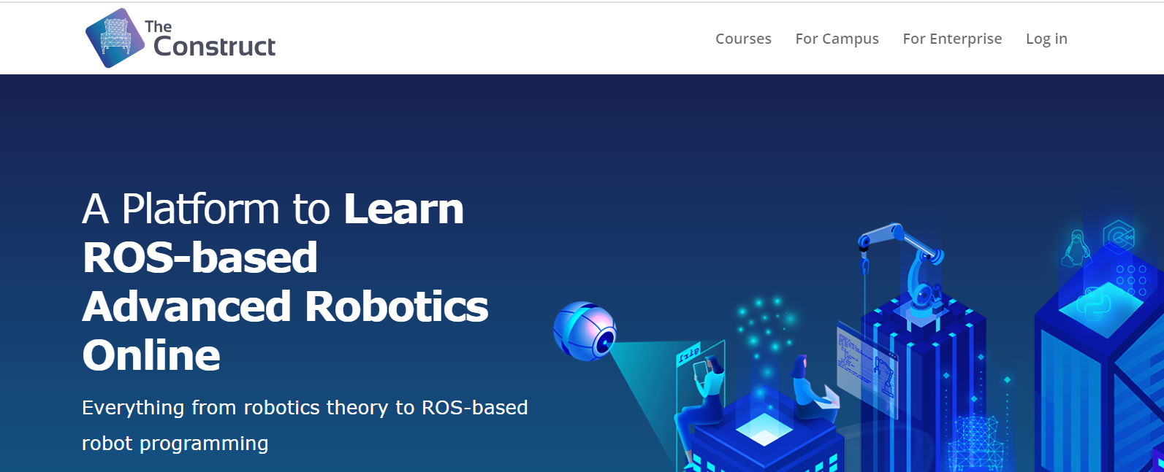
What platform will we use?
https://www.theconstructsim.com/

Slide 28
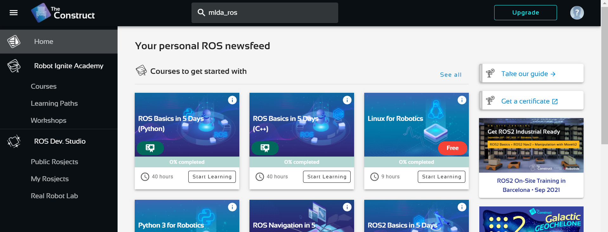

Slide 29
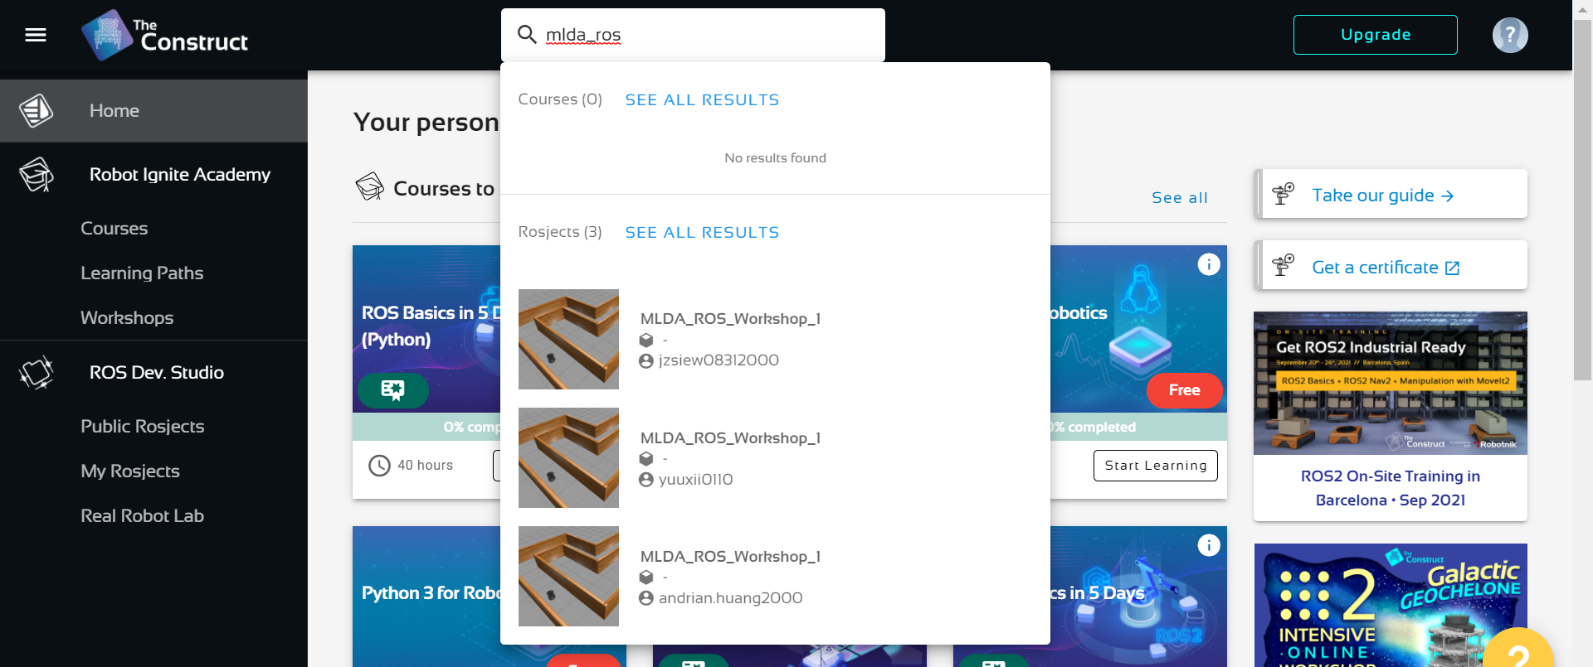

Slide 30
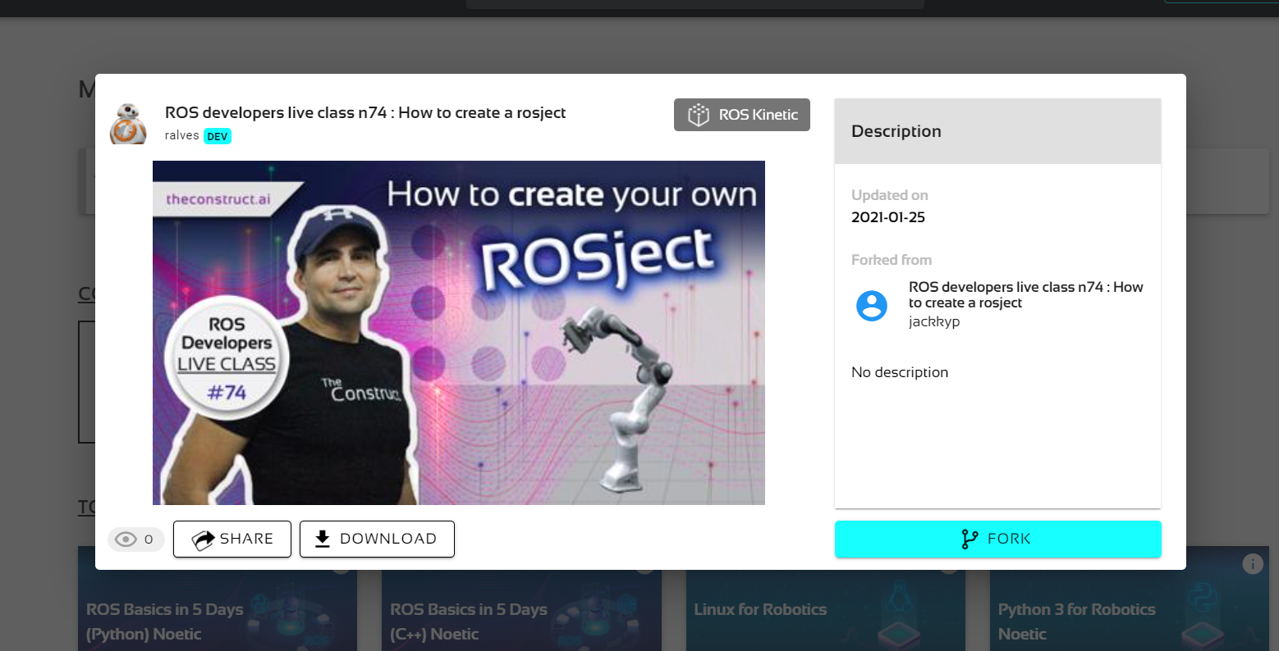

Slide 31
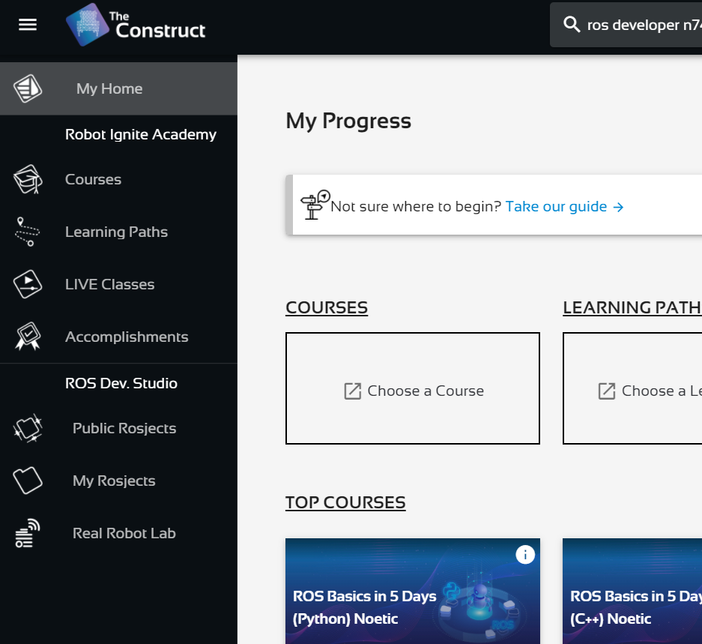

Slide 32
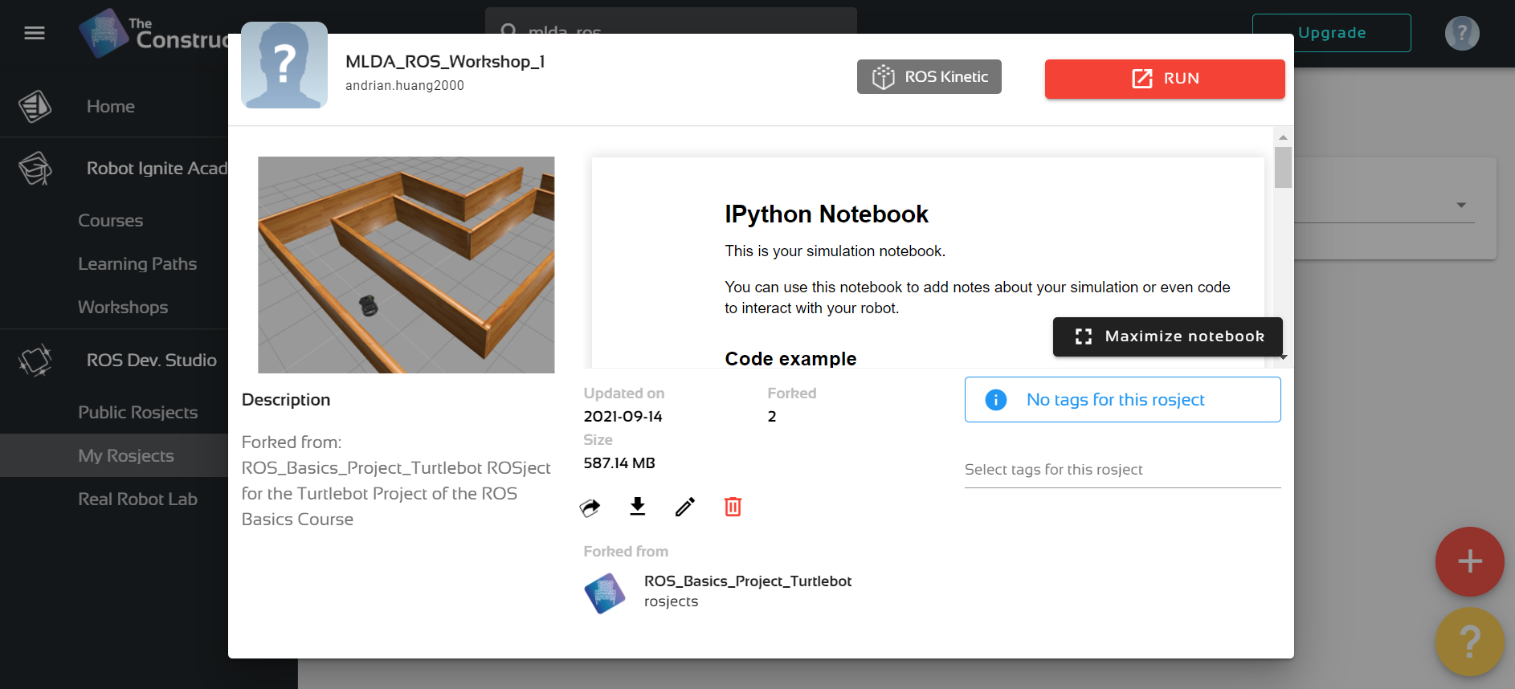

Slide 33
Hands-On! (things to be demoed)
How to create ROS package to put our codes in (catkin_create_pkg)
Writing simple Publisher and Subscriber in both Python and C++
How are we going to activate the codes/nodes (rosrun)
How to see the messages being published in ROS topics (rostopic info, echo)
How to see your nodes and topics connected (rqt_graph)
How to launch multiple nodes at once (roslaunch)
Demonstration on robot simulation: controlling the simulated robot using keyboard (cmd_vel and teleop)

Slide 34
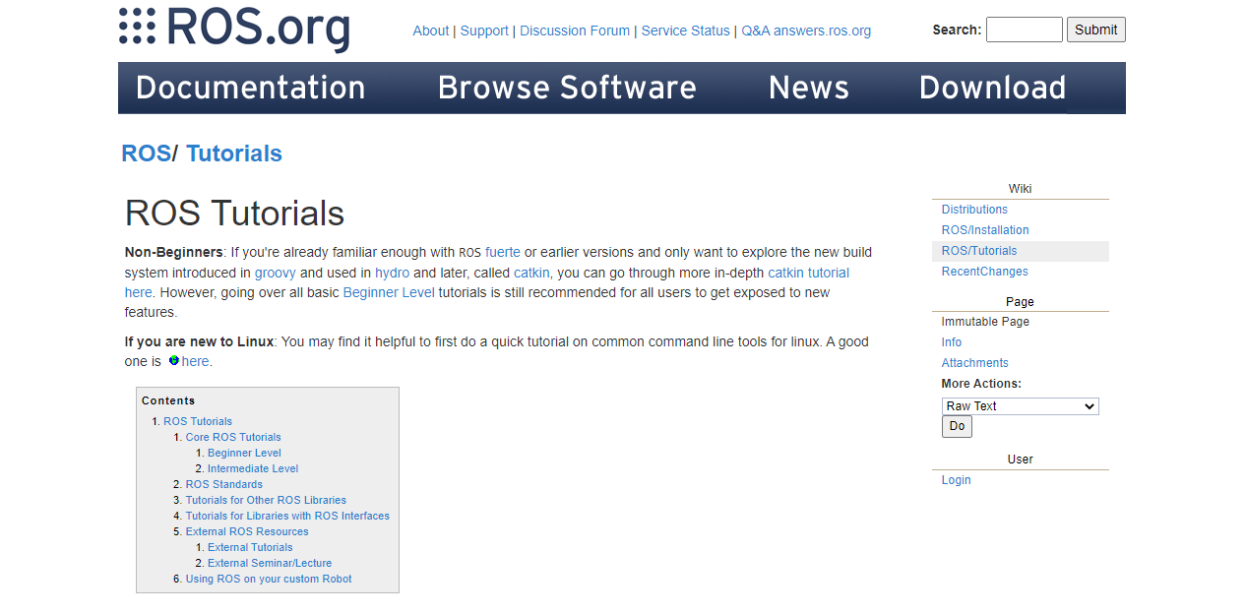
ROS Wiki & Official Guides
Notes:
Refer to official Wiki or online documentation! They will be useful I promise
A lot of us learn from these resources
Or stay tuned for our subsequent ROS workshop

Slide 35
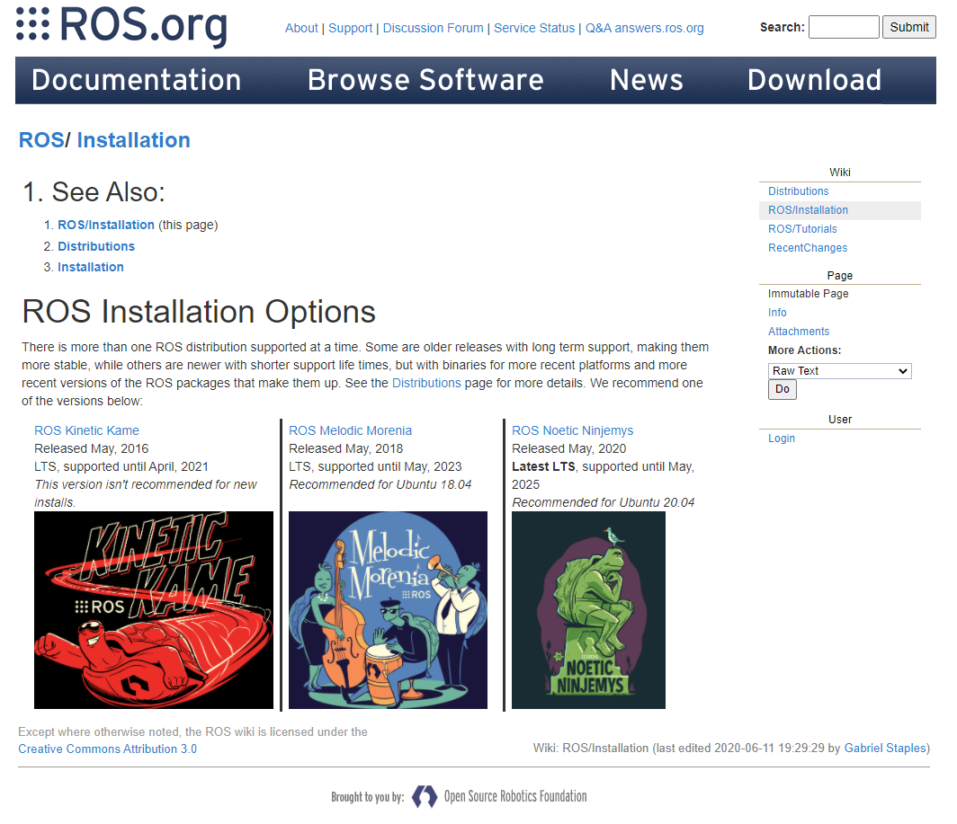
How to install normally?
Notes:
Normally you’d have to setup ROS on you machine (installing it)
This is covered in ROS official wiki

Slide 36




How to install normally?
Notes:
Installing ROS on your machine means you also need to install Ubuntu!
Or you can also use Docker to run ROS

Slide 37
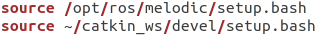
ConstructSim vs Local Installation (what we didn’t have to do today)
For local installation of ROS:
Need to run on Ubuntu (normally)
Need to install ROS, required dependencies, Catkin tools
Need to create your own workspace (e.g. catkin_ws)
Need to source ROS and catkin_ws in your terminal
Do NOT need internet connection (unless you want to communicate with other robots or some components of the robot need it)
And of course… local installation is way faster than ConstructSim!

Slide 38

Photo Session!
Please turn on your camera!

Slide 39

Thank You!
More ROS workshops from us coming soon!
https://forms.office.com/r/uT9y4ScTCp

